Slide 1
TIMS TRAINING

Slide 2
SEARCHING IN TIMS
Accessing TIMS via direct URL will bring you the search page.
You can search by SSN, name, or Other ID (employee ID)
https://tims.enrollonline.com/Login.aspx
Searches can be performed by SSN, employee ID number, or first and last name.

Slide 3
SEARCHING IN TIMS
Once the search criteria is entered, the results will appear on the right hand side of the screen.
Click on the link to the right to access that employee’s TIMS account.

Slide 4
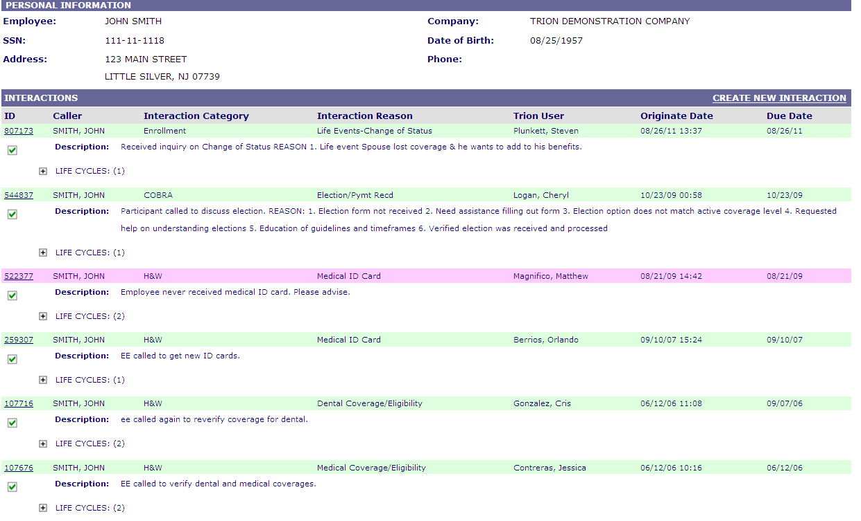
Member history and new tims
After completing the search from the main screen, the system will first bring you to the member’s TIMS history. Once a TIMS is created, it never goes away so all previously logged TIMS can be viewed from this screen.
To access a closed TIMS, click on the link of the interaction number.

Slide 5
Member history and new tims
To open a new interaction, click “Create New Interaction” in the upper right hand side of the history.

Slide 6
Member history and new TIMS
Caller Relationship
Employee
Spouse/Child
Human Resources
Carrier/Vendor
Other

Slide 7
Creating a new TIMS
Once the caller is selected, the interaction category and reason will need to be selected. For each interaction category, there is a corresponding set of reason codes.
Each category and reason group has pre-populated text templates associated with them that change based on the selected interaction reason.
These templates are completely customizable to allow for your own notes to be added.
Note that the Original User and the Originate Date cannot be adjusted.
The Due Date will be automatically set to 48 business hours after the Originate Date but is adjustable.
The first text box is the “Description” box and is to be used for documenting what the interaction is.

Slide 8
Creating a new TIMS

Slide 9
TIMS CATEGORIES AND REASONS
COBRA | FSA | Retirement | EnrollOnline | Other Website | Health Care Reform
Election/Pymt Recd | Receipt of Claim Inquiry | RET- Claim Interactions | Login Error | Login Error | Employee Benefits
Coupons | Reimbursement Check Status | RET- Billing Voucher Questions | System Block | System Block | Dependent Eligibility
COBRA-Eligibility w/carriers | Account Balance Inquiry | RET-Coverage/Eligibility | New Hire Enrollment Issue | New Hire Enrollment Issue | Pre Existing Conditions
COBRA Cost | Claim Denial Letter | RET-ID card Request | Open Enrollment Issue | Open Enrollment Issue | Health Care Costs
Non-Pymt/Termination | Card Substantiation Letter | RET-Pharmacy | QLE Issue | QLE Issue | FSA
Conversion | Expense Eligibility Inquiry | 401K | FSA | FSA | Medicare
COBRA-Other | Card Not Working | RET-Pension Questions | COBRA | COBRA | Summary of Benefit Coverage (SBC) Request
Life Events | Card Suspended | RET-Status of Retirement | Questions | Questions | Other
Census Update | Lost/Stolen Card | RET-Other
ACH | Request for Forms
Appeal/Exceptions | FSA - Other
Data Security Issue | Appeals/Exceptions
Medicare Eligibility | Wired Commute Inquiry
H&W | H&W (cont’d) | Enrollment | General/Misc | VB | Health Care Reform
Medical Coverage | Vision HMO Application/Forms | New Hire Enrollment | Payroll Deductions | New Hire Enrollment | Employee Benefits
Medical ID Card | Vision Claim Issue | Open Enrollment | Add/Phone/Name Change | Open Enrollment | Dependent Eligibility
Medical HMO Application/Forms | Vision-Other | Problem w/enrollment | SSN | Policy Question/Update | Pre Existing Conditions
Pharmacy-Formulary/Mail Order | Life/AD&D/EOI | Enrollment Kit not recd | SPD | Coverage Question | Health Care Costs
Medical Claim Issue | Disability/FLMA/LOA/Vacation | FTS Verification | General Misc/Other | Claim Issue | FSA
Medical - Other | Beneficiaries | Life Events-Change of Status |  | Billing Issue | Medicare
Dental Coverage/Eligibility | Appeals/Exceptions | Dependent Information |  | Cancellation | Summary of Benefit Coverage (SBC) Request
Dental ID Card | Health Reimb./Savings Acct. Inquiry | Enrollment -Other |  | Transferred Call/Redirect | Other
Dental HMO Application | Rx Coverage/Eligibility | OE Worksheet/Paper Processing |  | VB – Other
Dental Claim Issue | RX ID Cards Inquiry | EnrollOnline Certifications
Dental Other | PHP Inquiry | Surcharge Inquiry
Vision Coverage/Eligibility | Wellness/Discount Programs | Benefit Eligibility Inquiry
Vision ID Card |  | Imputed Income Inquiry
HSA | ACA | LOA | ESP | MyMarketlink | Life Claims
Account Balance Inquiry | Login Error | ACH | Enrolling | Login Error | Life Claims
Expense Eligibility Inquiry | System Block | Cost | Investing | System Block | AD&D Claims
Card Not Working | Request for Forms | LOA - Other | Selling | New Hire Enrollment Issue | Claim Status
Card Suspended | Reporting Issue | Non-Pymt/Termination | Forms | QLE Issue
Lost/Stolen Card | ACA-Other | Coupons | Balance Statements | Questions
Appeals/Exceptions |  |  | Other
Balance Transfers
Account Setup
HSA-Other
Request For Forms
Contribution Changes

Slide 10
Creating a new TIMS
Make sure to check the PHI and Close Interaction check boxes when creating a TIMS.
Both will be automatically checked when creating a new TIMS.
Leaving the PHI box checked will lock the TIMS to non-Trion users.
Examples of when to leave the PHI box checked:
Employee calls in to discuss medical conditions for themselves or dependents
Employee calls to discuss leaving the company and has questions regarding their benefits
Employee explicitly advises they do not want their employer to know of a topic that has discussed
To adjust the Close Interaction check box, you will need to adjust the Interaction Tier. This drop-down box can be found on the top right of the “Action” text box at the bottom of TIMS.
Once the Tier is changed, notice how the “Resolution” and “Interaction Status” drop-down boxes will automatically adjust.
By moving to Tier 2, 3, or 4, this will leave the interaction in an open status.

Slide 11
Creating a new TIMS
Once the interaction has been documented in the Description and Action text boxes, you can determine if the TIMS needs to be forwarded to another user. The “Forwarded To” drop-down” box will list all of the TIMS users that the interaction can be sent to.
Lastly, check the Interaction Severity. There are three levels
Callback Due Date
Normal 2 business days
Escalated 1 business days
Urgent Less than 1 business day
After all areas have been checked, click the “Create Interaction” button at the bottom of TIMS.

Slide 12
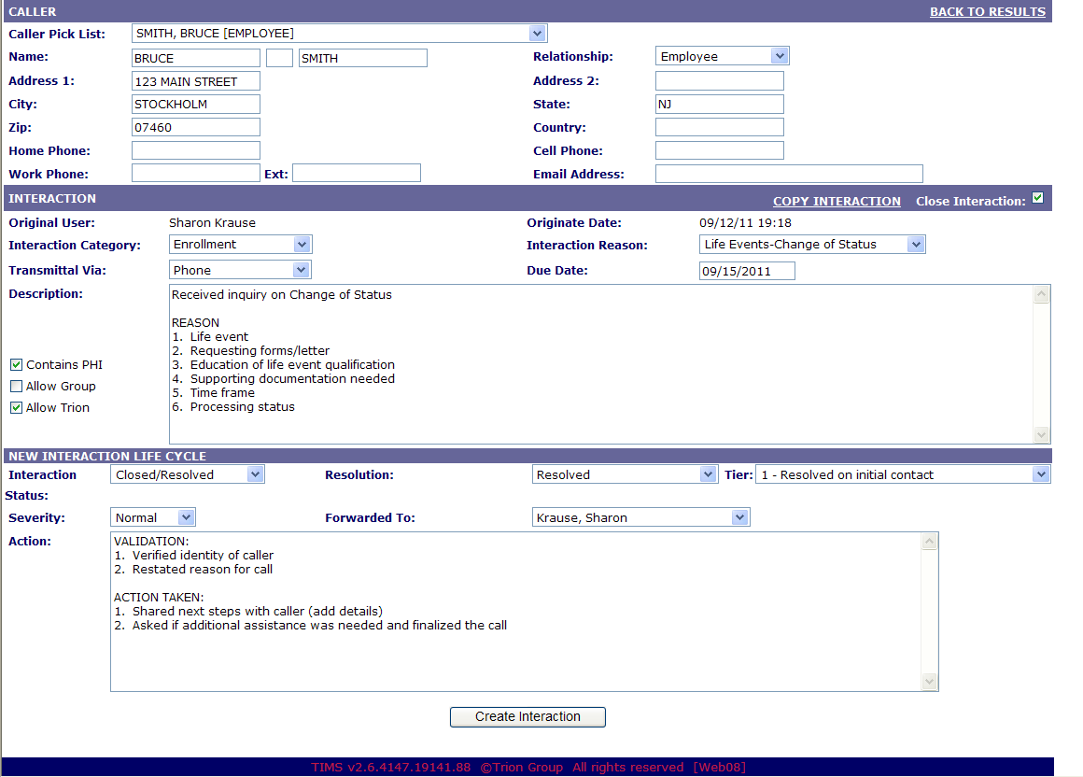
Creating a new TIMS
1
2
Select who the caller is.
Enter the current phone number
3
Select category and reason
5
Information about the inquiry
4
Uncheck ‘Contains PHI’ if it does not apply
6
Resolution needed or Resolution that was provided
9
10
8
7
Change the severity if needed
Update the Tier if needed
If resolution is needed send to the appropriate location
Update the Tier if needed

Slide 13
Creating a new TIMS
1
2
Select who the caller is.
Enter the current phone number
3
Select category and reason
5
Information about the inquiry
4
Uncheck ‘Contains PHI’ if it does not apply
6
Resolution needed or Resolution that was provided
9
10
8
7
Change the severity if needed
Update the Tier if needed
If resolution is needed send to the appropriate location
Update the Tier if needed

Slide 14
Creating a new TIMS
1
2
Select who the caller is.
Enter the current phone number
3
Select category and reason
5
Information about the inquiry
4
Uncheck ‘Contains PHI’ if it does not apply
6
Resolution needed or Resolution that was provided
9
10
8
7
Change the severity if needed
Update the Tier if needed
If resolution is needed send to the appropriate location
Update the Tier if needed

Slide 15
Creating a new TIMS
1
2
Select who the caller is.
Enter the current phone number
3
Select category and reason
5
Information about the inquiry
4
Uncheck ‘Contains PHI’ if it does not apply
6
Resolution needed or Resolution that was provided
9
10
8
7
Change the severity if needed
Update the Tier if needed
If resolution is needed send to the appropriate location
Update the Tier if needed

Slide 16
Creating a new TIMS
1
2
Select who the caller is.
Enter the current phone number
3
Select category and reason
5
Information about the inquiry
4
Uncheck ‘Contains PHI’ if it does not apply
6
Resolution needed or Resolution that was provided
9
10
8
7
Change the severity if needed
Update the Tier if needed
If resolution is needed send to the appropriate location
Update the Tier if needed

Slide 17
Creating a new TIMS
1
2
Select who the caller is.
Enter the current phone number
3
Select category and reason
5
Information about the inquiry
4
Uncheck ‘Contains PHI’ if it does not apply
6
Resolution needed or Resolution that was provided
9
10
8
7
Change the severity if needed
Update the Tier if needed
If resolution is needed send to the appropriate location
Update the Tier if needed

Slide 18
Creating a new TIMS
1
2
Select who the caller is.
Enter the current phone number
3
Select category and reason
5
Information about the inquiry
4
Uncheck ‘Contains PHI’ if it does not apply
6
Resolution needed or Resolution that was provided
9
10
8
7
Change the severity if needed
Update the Tier if needed
If resolution is needed send to the appropriate location
Update the Tier if needed

Slide 19
Creating a new TIMS
1
2
Select who the caller is.
Enter the current phone number
3
Select category and reason
5
Information about the inquiry
4
Uncheck ‘Contains PHI’ if it does not apply
6
Resolution needed or Resolution that was provided
9
10
8
7
Change the severity if needed
Update the Tier if needed
If resolution is needed send to the appropriate location
Update the Tier if needed

Slide 20
Creating a new TIMS
1
2
Select who the caller is.
Enter the current phone number
3
Select category and reason
5
Information about the inquiry
4
Uncheck ‘Contains PHI’ if it does not apply
6
Resolution needed or Resolution that was provided
9
10
8
7
Change the severity if needed
Update the Tier if needed
If resolution is needed send to the appropriate location
Update the Tier if needed

Slide 21
Creating a new TIMS
1
2
Select who the caller is.
Enter the current phone number
3
Select category and reason
5
Information about the inquiry
4
Uncheck ‘Contains PHI’ if it does not apply
6
Resolution needed or Resolution that was provided
9
10
8
7
Change the severity if needed
Update the Tier if needed
If resolution is needed send to the appropriate location
Update the Tier if needed

Slide 22
Creating a new TIMS
1
2
Select who the caller is.
Enter the current phone number
3
Select category and reason
5
Information about the inquiry
4
Uncheck ‘Contains PHI’ if it does not apply
6
Resolution needed or Resolution that was provided
9
10
8
7
Change the severity if needed
Update the Tier if needed
If resolution is needed send to the appropriate location
Update the Tier if needed

Slide 23
Running a TIMS report
To run a report, pull the client name from the left box over to the right box by highlighting it and clicking on the single right-hand arrow.
Select the user you wish to run a report for.
Leaving the user field blank will run a report for all users.
The report criteria can be adjusted by a number of different fields depending on what it is you’re looking for.
The company name on the left hand side of the report is the link to that individual TIMS interaction

Slide 24
Running a TIMS report
TIMS reports are mainly used to track open interactions in either Tier 2,3, or 4 status. They can also be run to check Tier 1 (closed) interactions.
Reports will indicate the following information:
Employee name and SSN
Originate date of the TIMS
Due date of the TIMS
Interaction Category
Interaction Reason
Original and current users
“Forwarded to” user
Severity
Tier
Open/Close status

Slide 25
Running a TIMS report
To run a report, click on “Reports” in the upper right hand corner of any screen. It will bring you to the reports home screen.

Slide 26
Running a TIMS report

