Slide 1
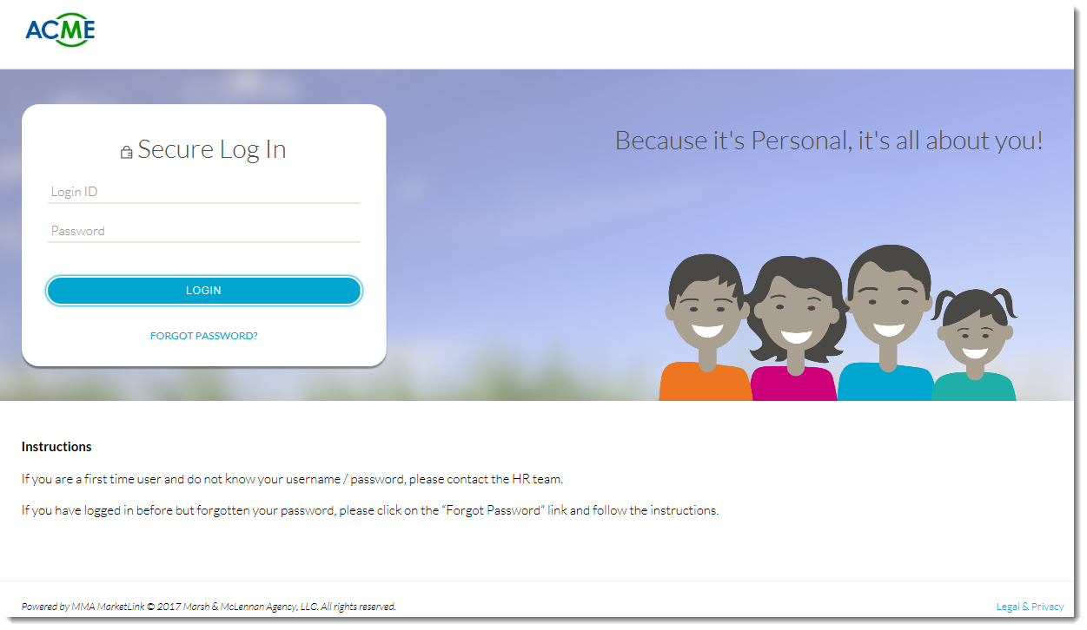
MMA MarketLink
Easy, step by step enrollment!
www.mymarketlink.com/clientname

Slide 2
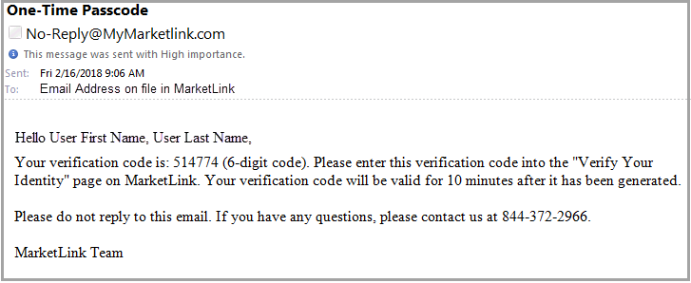
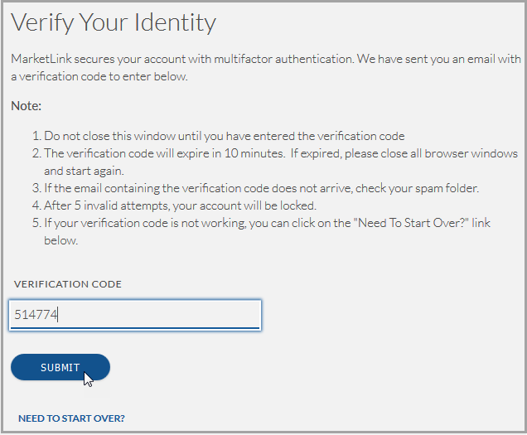
MMA MarketLink
Multi-Factor Authentication
You will only be asked to provide a second layer of authentication once every 400 days, unless, you login from a different browser, device or operating system in which case, you will be asked to re-authenticate.
Once you login using your credentials, you’ll receive an email to the email address stored in MarketLink which includes the Verification Code. .
A Verify You Identity screen will then pop up. Enter the Verification Code and click on Submit. You’ll then be taken to the Benefit Portal.

Slide 3
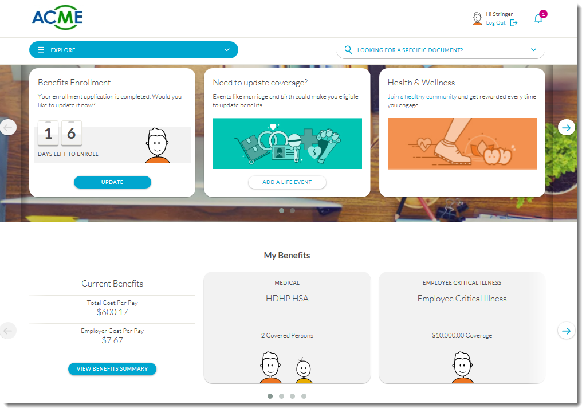
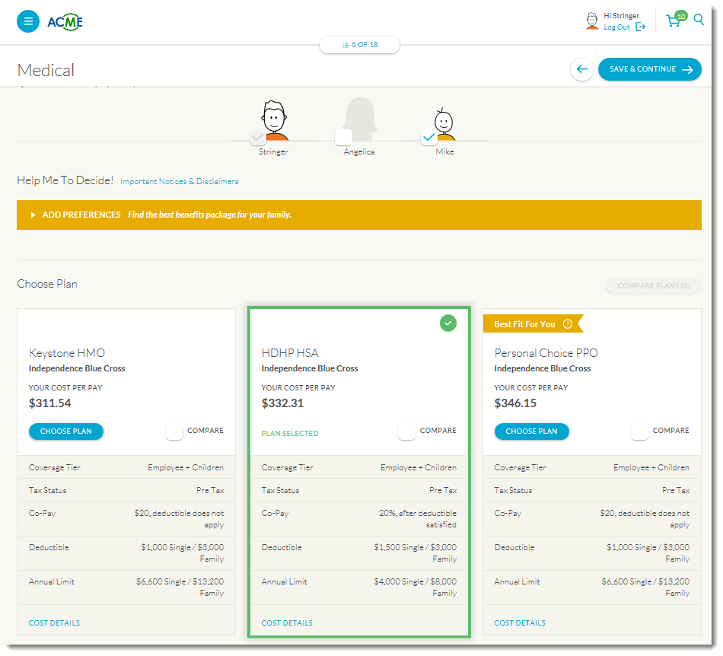
MMA MarketLink
Your Online Enrollment Platform!
Easy access benefits information 24/7 from your web-enabled devices
Step-by-step instructions to make your benefit elections
View your benefits summary and other important resources and forms
Make Qualifying Life Event Changes
Engage in the Health & Wellness platform to maintain your personal well-being

